Slide 1
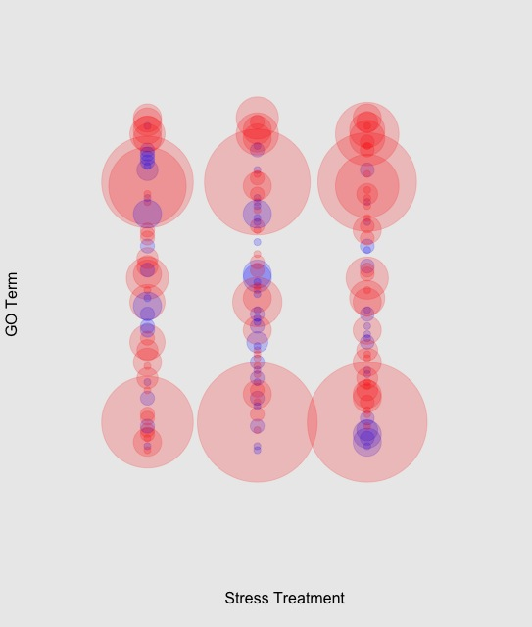
response to stress
viral reproduction
response to oxidative stress
response to oxidative stress
phagocytosis, engulfment
neg. reg. of apoptosis
toll-receptor signaling
antigen processing
anti-apoptosis
apoptosis
Ocean Acidification + Mechanical Stress
Ocean Acidification
Mechanical Stress

Slide 2
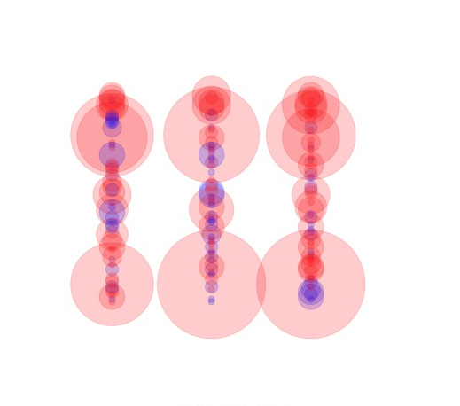
response to stress
viral reproduction
response to oxidative stress
response to oxidative stress
phagocytosis, engulfment
neg. reg. of apoptosis
GO Term
toll-receptor signaling
antigen processing
anti-apoptosis
apoptosis
Ocean Acidification + Mechanical Stress
Ocean Acidification
Mechanical Stress
Stress Response

